Slide 1
ToF Imaging Refinement
Yanfeng Tong
2019.9.5
1
Notes:
1

Slide 2
Contents
1.ToF depth imaging and core challenges
a. Depth acquisition
b. Multi-path interference(MPI)
c. Phase unwrapping
2.FLAT
a. Contribution
b. Dataset
c. Network Architecture
d. Results & Performance
3.DeepToF
a. Contribution
b. Dataset
c. Network Architecture
d. Results & Performance
4.ToFNet
a. Contribution
b. Network Architecture
c. Loss function
d. Performance
5.Domain Adaptation

Slide 3
Contents
1.ToF depth imaging and core challenges
a. Depth acquisition
b. Multi-path interference(MPI)
c. Phase unwrapping
2.FLAT
a. Contribution
b. Dataset
c. Network Architecture
d. Results & Performance
3.DeepToF
a. Contribution
b. Dataset
c. Network Architecture
d. Results & Performance
4.ToFNet
a. Contribution
b. Network Architecture
c. Loss function
d. Performance
5.Domain Adaptation

Slide 4
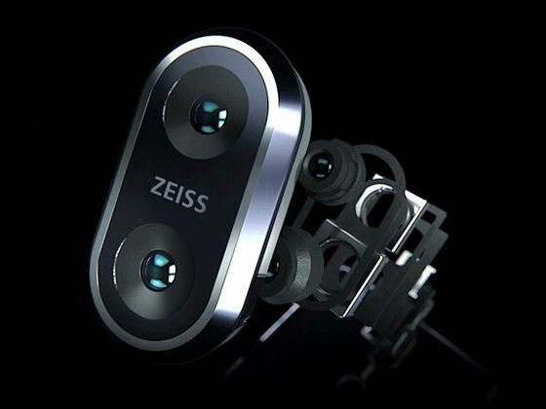
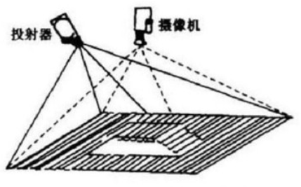
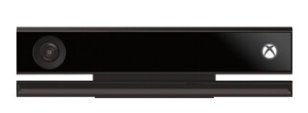
Depth acquisition
1.Stereo metching
2.Structure light
3.ToF

Slide 5
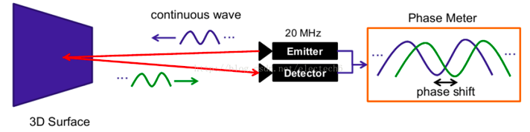
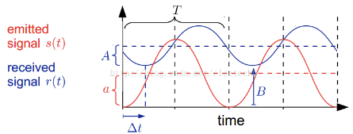
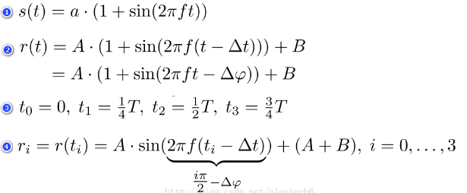
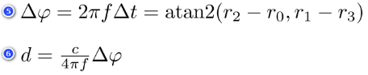
ToF Imaging Process
1.Depth acquisition

Slide 6
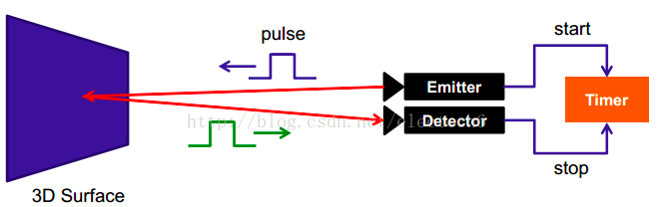
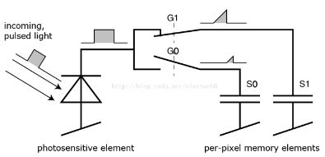
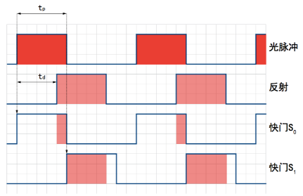

Slide 7
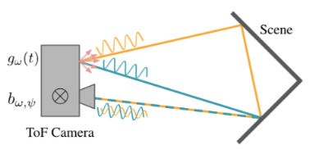
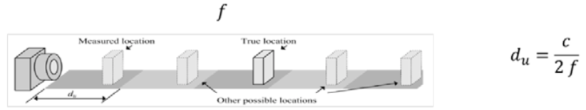
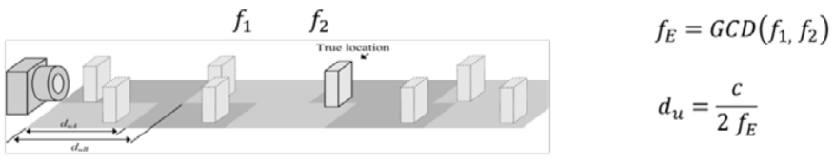
2.Multi-path interference(MPI)
3.Phase unwrapping

Slide 8
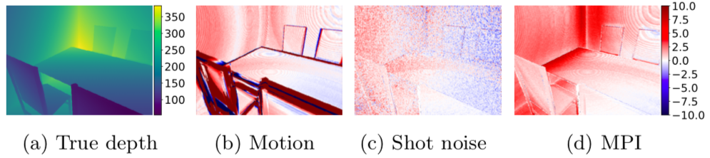
FLAT：Tackling 3D ToF Artifacts Through Learning and the FLAT Dataset
contribution：
1.dataset；
2.DNN architecture；
1.dataset：
a. 2000 scene response functions；
b. 3 kind of camera(Kinect v2, Phasor, Deeptof)
c. each scene takes 10 cpu hours to rander

Slide 9
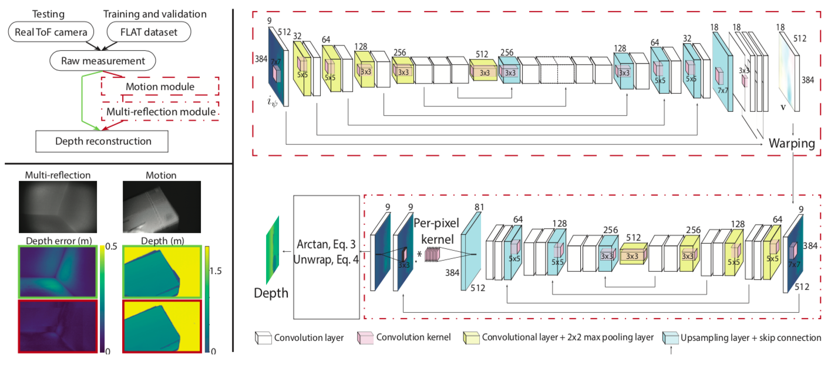
DNN architecture

Slide 10
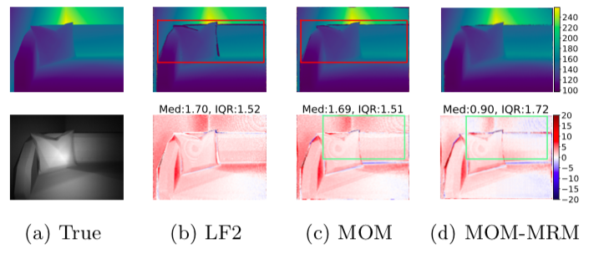
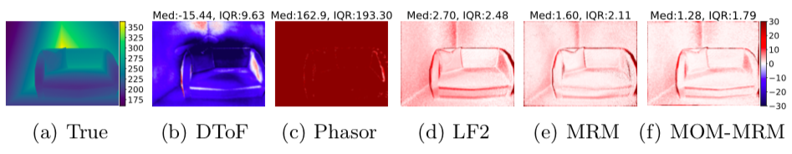
Result

Slide 11
Contents
1.ToF depth imaging and core challenges
a. Depth acquisition
b. Multi-path interference(MPI)
c. Phase unwrapping
2.FLAT
a. Contribution
b. Dataset
c. Network Architecture
d. Results & Performance
3.DeepToF
a. Contribution
b. Dataset
c. Network Architecture
d. Results & Performance
4.ToFNet
a. Contribution
b. Network Architecture
c. Loss function
d. Performance
5.Domain Adaptation

Slide 12
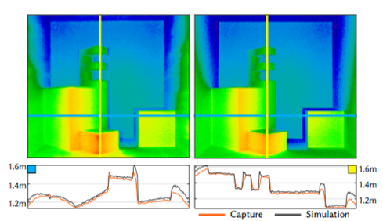
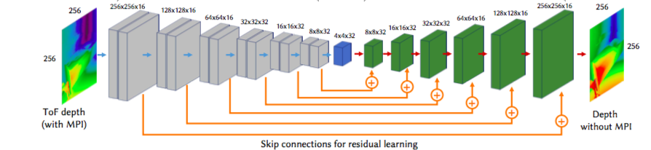
Deep ToF :Off-the-Shelf Real-Time Correction of Multipath Interference in Time-of-Flight Imaging
Contribution
1.A synthetic ToF dataset of scenes sharing similar statistical
properties as real-world scenes. For each scene, they provides
both MPI-corrupted and ground-truth depth.
2. A two-stage training strategy, with a convolution alautoencoder plus a residual learning approach.
It leverages statistical knowledge from real captured data with no ground truth, and then compensates the error from synthetic data.
3. A trained network that compensates multipath interference from a single ToF depth image in real time.

Slide 13
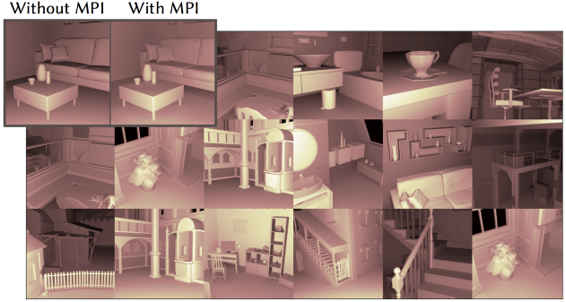
Dataset
Synthetic dataset:1050 images(8400 by flip&rotate）
1.Use ideal sinusoidal functions to avoid introducing non-MPI-related error sources.
(square modulation functions introduces additional errors on the depth estimation，the effect and its correction are specific for each camera, and in general information is not provided by manufacturers)
2.25 different scenes with varying materials, using 6 different albedo, rendered from 7 different viewpoints, computed with up to 20 bounces of indirect lighting. 256*256 resolution.
Real dataset:6000(48000)
PMD camera, without GT

Slide 14
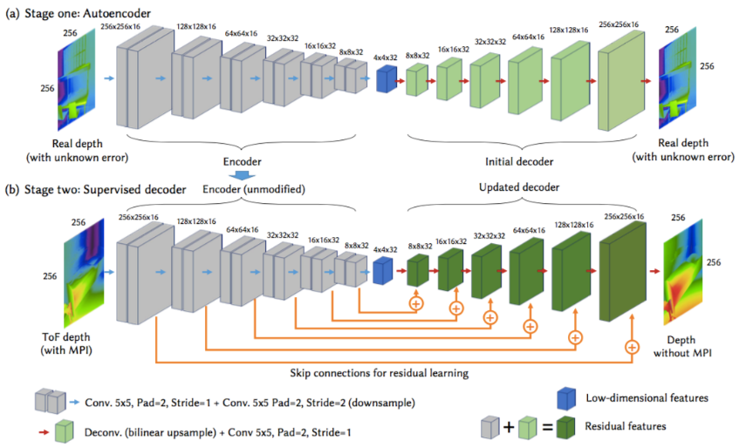
Network Architecture
^{Two-stage scheme with}
the real dataset (during autoencoding)
&
synthetic dataset (during supervised decoding).
^{Stage one: autoencoder}
use this incorrect depth as input and output for this unsupervised training, and use the synthetic dataset (with MPI) as its validation set.
^{Stage two: supervised decoder}
Freeze the encoder layers, and train the decoder through supervised learning using their synthetic dataset.

Slide 15
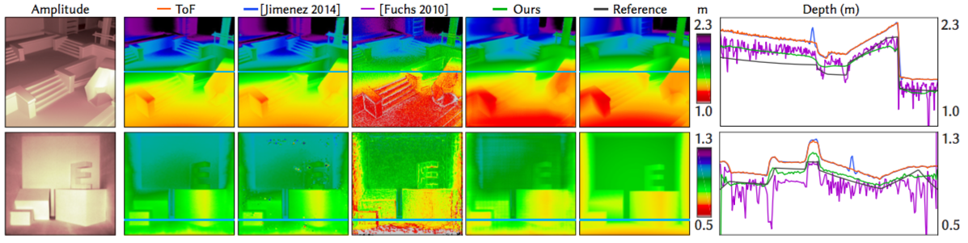
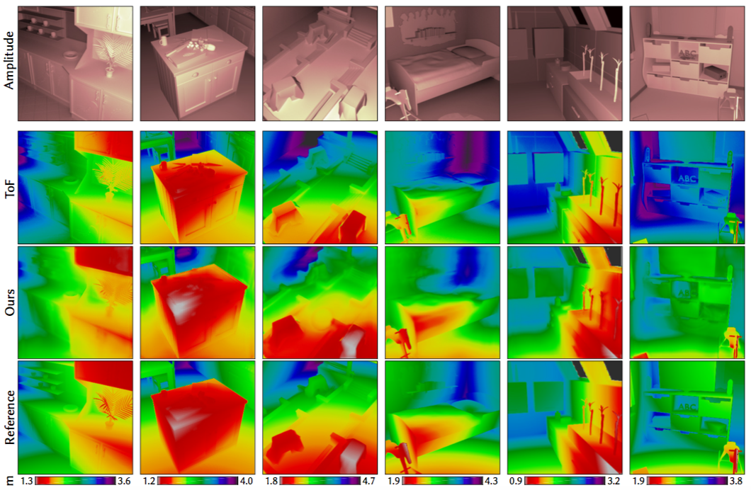
Performance

Slide 16
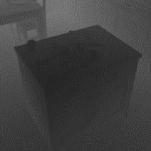
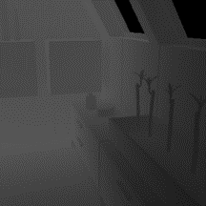
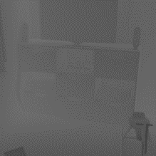
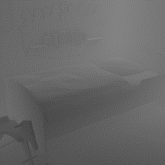
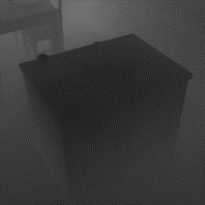
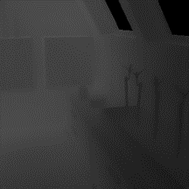
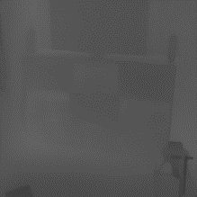
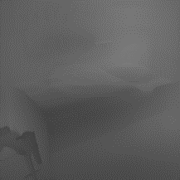
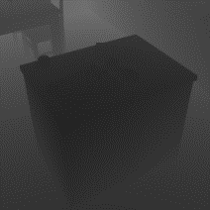
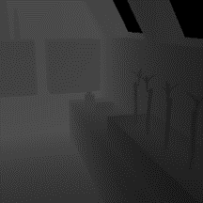
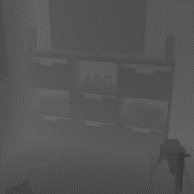
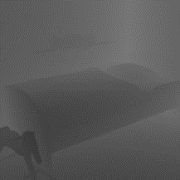
input
output
label

Slide 17
Contents
1.ToF depth imaging and core challenges
a. Depth acquisition
b. Multi-path interference(MPI)
c. Phase unwrapping
2.FLAT
a. Contribution
b. Dataset
c. Network Architecture
d. Results & Performance
3.DeepToF
a. Contribution
b. Dataset
c. Network Architecture
d. Results & Performance
4.ToFNet
a. Contribution
b. Network Architecture
c. Loss function
d. Performance
5.Domain Adaptation

Slide 18
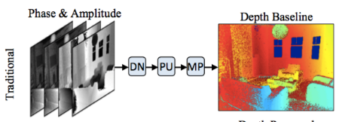
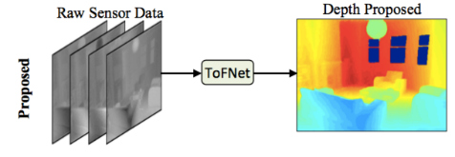
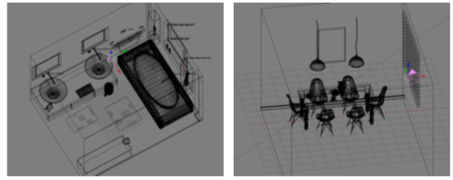
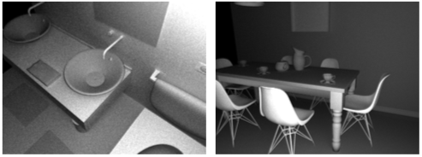
Deep end to end ToF imaging (ToFNet)
Contributions
1.Learning-based approach for end to end ToF imaging by jointly solving phase unwarpping, MPI, denoising from raw correlation measurements.
2.Setup a large-scale raw correlation ToF dataset with known ground truth labels for every pixel. pbrt-v3

Slide 19
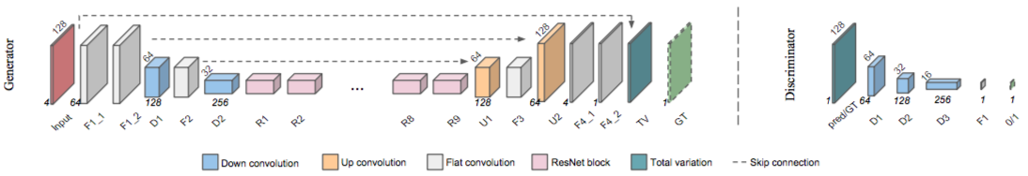
Network Architecture
Network consisting of :
left: a symmetrically skip-connected encoder-decoder generator network G, right: a discriminator network D.
Both G and D are trained on 128 × 128 patches
1.treat depth generation as a multi-channel image fusion problem where a desired depth map is the weighted combination of the same scene measured at multiple [ω_{i} , ψ_{j} ] illumination-sensor configurations.
2. the input correlation measurements and output depth images should both be consistent with the underlying scene geometry, while the two should share depth gradients

Slide 20
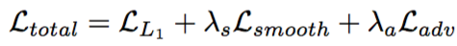
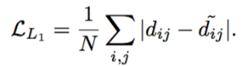
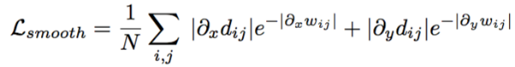
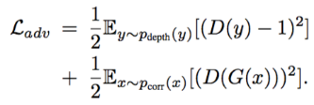
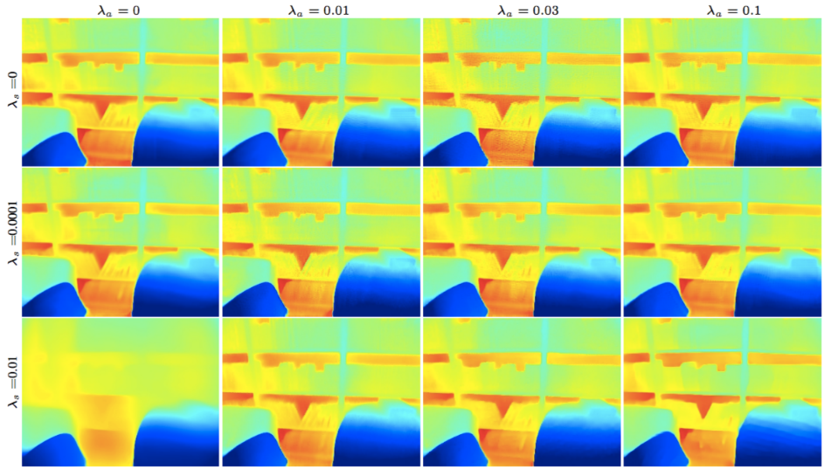
Loss function
λ_{s} =0.0001
λ_{a} =0.1

Slide 21
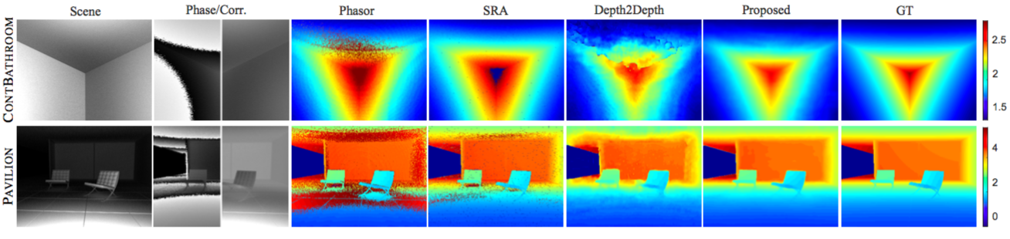
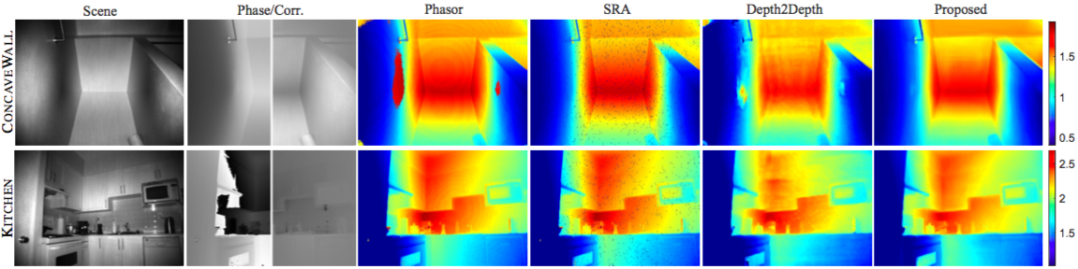
Performance

Slide 22
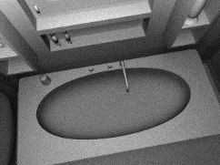
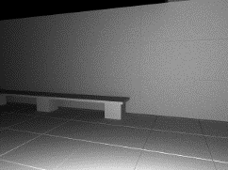
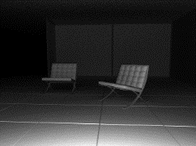













amplitude
tof_depth
GT
output

Slide 23
Contents
1.ToF depth imaging and core challenges
a. Depth acquisition
b. Multi-path interference(MPI)
c. Phase unwrapping
2.FLAT
a. Contribution
b. Dataset
c. Network Architecture
d. Results & Performance
3.DeepToF
a. Contribution
b. Dataset
c. Network Architecture
d. Results & Performance
4.ToFNet
a. Contribution
b. Network Architecture
c. Loss function
d. Performance
5.Domain Adaptation

Slide 24

Domain Adaptation
source domain
target domain
Necessary assumption :
1.the source and target domains share the same label space;
2. the source model achieves performance greater than chance on the target domain;
label
fully & dense
no label
quantity
lots of
less
distribution
domain shift

Slide 25
Thanks for your attention!
25

